Slide 1
Training a Multilayer Perceptron with Stochastic Gradient Descent
Landon Buell
11 March 2020

Slide 2
Overview
Introduction to Multilayer Perceptron
Mathematical Treatment & Forward Feeding
Minimizing the Error Function
Correcting with Gradient Descent
Understanding the Scikit Learn Implimentation

Slide 3
The Multilayer Perceptron Classifier
Sklearn : “MLPClassifier”

Slide 4
Layout
Common Architecture
A Series of “layers”
Each layer of made up of Nodes or Neurons

Slide 5
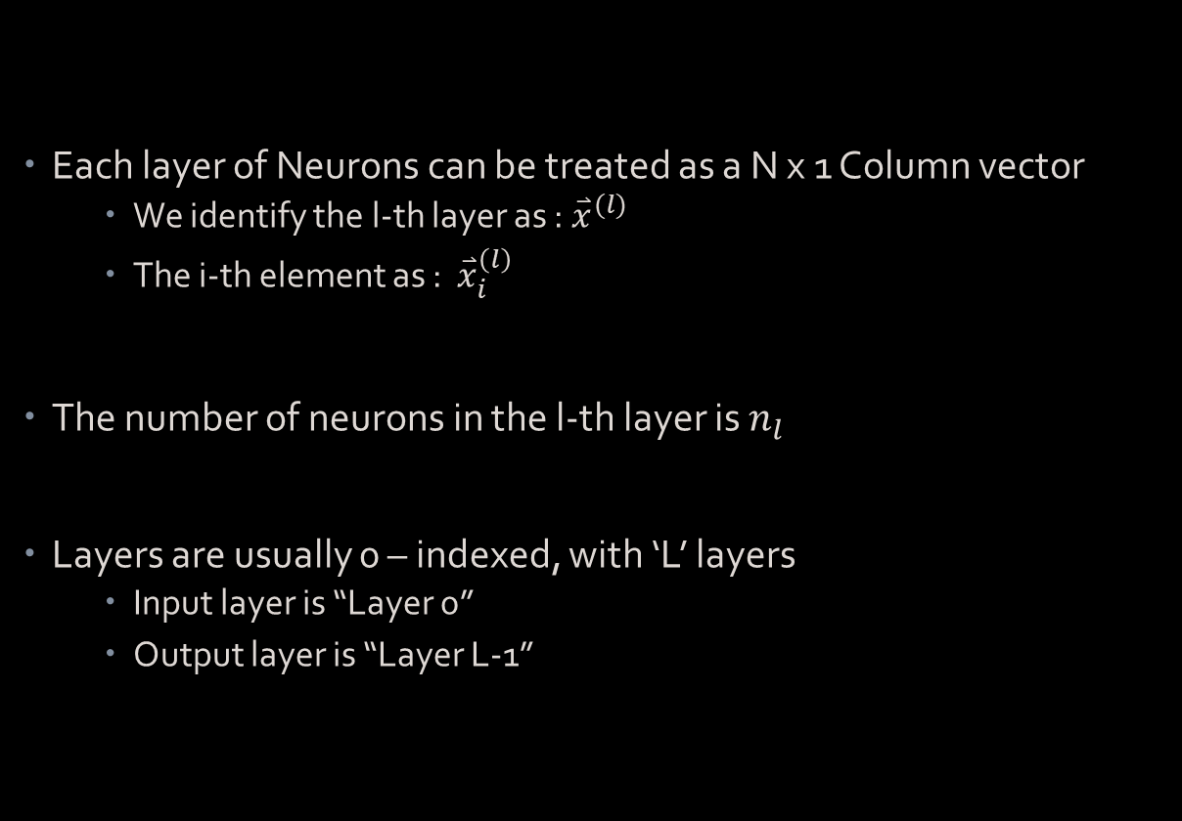
Mathematical Treatment
Each layer of Neurons can be treated as a N x 1 Column vector
We identify the l-th layer as : ${\overset{⃑}{x}}^{(l)}$
The i-th element as : ${\overset{⃑}{x}}_{i}^{\left(l\right)}$
The number of neurons in the l-th layer is $n_{l}$
Layers are usually 0 – indexed, with ‘L’ layers
Input layer is “Layer 0”
Output layer is “Layer L-1”

Slide 6

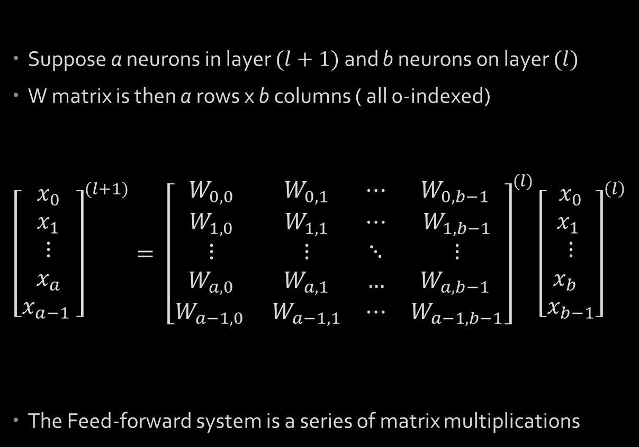
Feed-Forward System
Suppose a neurons in layer $(l+1)$ and b neurons on layer $(l)$
W matrix is then a rows x b columns ( all 0-indexed)
$${\left[\begin{matrix}x_{0} \\ x_{1} \\ ⋮ \\ x_{a} \\ x_{a−1} \end{matrix}\right]}^{(l+1)}= {\left[\begin{matrix}W_{0,0} & W_{0,1} & ⋯ & W_{0,b−1 } \\ W_{1,0} & W_{1,1} & ⋯ & W_{1,b−1} \\ ⋮ & ⋮ & ⋱ & ⋮ \\ W_{a,0} & W_{a,1} & … & W_{a,b−1 } \\ W_{a−1,0 } & W_{a−1,1} & ⋯ & W_{a−1,b−1}\end{matrix}\right]}^{(l)}{\left[\begin{matrix}x_{0} \\ x_{1} \\ ⋮ \\ x_{b} \\ x_{b−1}\end{matrix}\right]}^{\left(l\right) }$$
The Feed-forward system is a series of matrix multiplications
Matrix – Vector Equation:
$${\overset{⃑}{x}}^{l+1}=W^{l}{\overset{⃑}{x}}^{l}$$

Slide 7
The Cost Function
The function to minimize

Slide 8
Nature of the Function
Cost function – Error Function – Objective Function – Loss Function
This is the function that we try to minimize
It is a function of the MLP’s output and the target associated with a training sample

Slide 9

Computing the Cost Function
The Network’s final layer (L-1) outputs a vector
For a k-bins classifier, this vector is shaped: $k×1$
The target associated with the sample is also arranged into a $k×1$ vector.

Slide 10
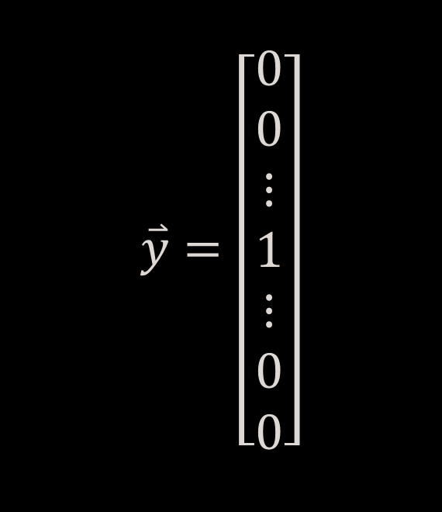
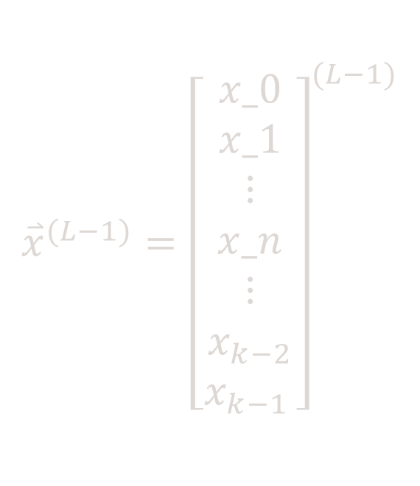
Example Output Suppose Sample belongs to class ‘n’
MLP Output Vector
Sample Target Vector
$${\overset{⃑}{x}}^{(L−1)}={\left[\begin{matrix}x_0 \\ x_1 \\ ⋮ \\ x_n \\ ⋮ \\ x_{k−2} \\ x_{k−1 }\end{matrix}\right]}^{(L−1)}$$
$$\overset{⃑}{y}=\left[\begin{matrix}0 \\ 0 \\ ⋮ \\ 1 \\ ⋮ \\ 0 \\ 0\end{matrix}\right]$$

Slide 11
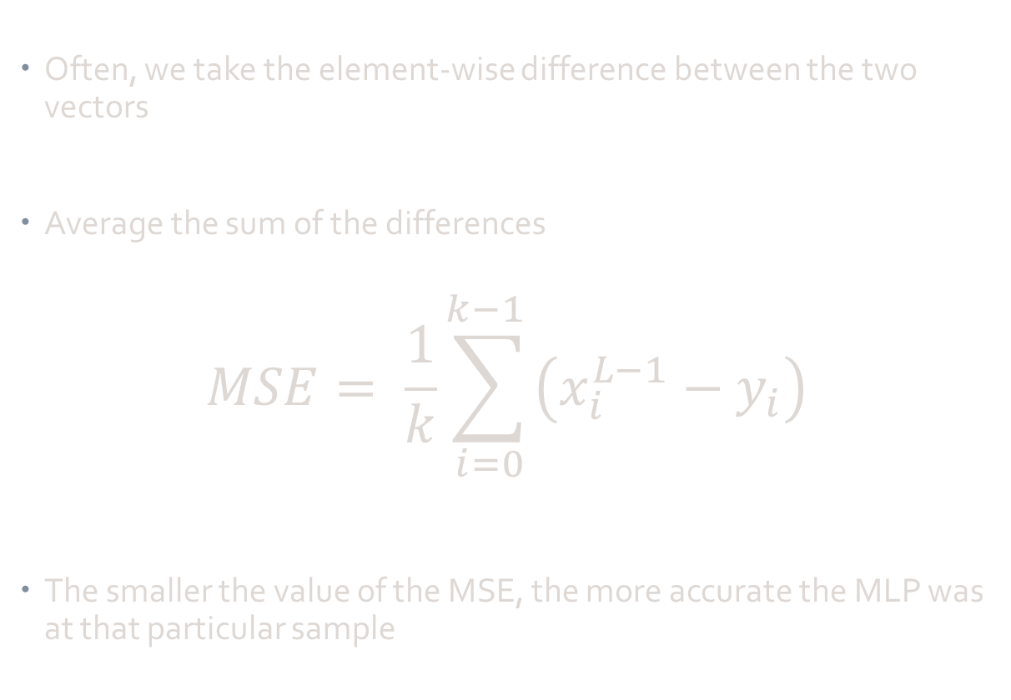
Mean Squared Error
Often, we take the element-wise difference between the two vectors
Average the sum of the differences
$$MSE= \frac{1}{k}\sum_{i=0}^{k−1 }{\left(x_{i}^{L−1}−y_{i}\right)}$$
The smaller the value of the MSE, the more accurate the MLP was at that particular sample

Slide 12
How to minimize the cost function?

Slide 13
Stochastic Gradient Descent
Training Algorithm

Slide 14
The Cost Function Revisited
The Cost function is the function of the MLP output and the target vector
The output of the MLP is a function of the input vector
The input vector is transformed through each weighting matrix
Thus, the cost function is a function of all the weighting matrices

Slide 15
Implications
The Cost function is then determined by many variables
Every element in every weighting matrix contributes to the error function
For larger networks, this can extend to several thousand variables
We use Stochastic Gradient Descent to adjust these inputs

Slide 16
Multilayer Peceptron Implementation
Sklearn : “MLPClassifier”

